Slide 1


5. DATABASE SYSTEMS
Айтмұханбетова Эльвира
D. Serikbayev East Kazakhstan State Technical University
ICT Spring 2019
Notes:
Welcome to this series! In the next several videos, we introduce database concepts.

Slide 2

Copyright Notice
© tutorialspoint
This presentation uses materials from tutorialspoint’s Database Management System Tutorial
  https://www.tutorialspoint.com/dbms/

Slide 3
5.1: Introduction to Database Systems
5.1: Introduction to Database Systems
5.2: Data Models
5.3: ER Diagram Representation
Notes:
During part one of this three-part series, we introduce the topic of Database Systems.

Slide 4
Learning Objectives
Define database, DBMS and database systems
Describe the database importance and its functions
List database characteristics
Understand business rules
Define database users
Understand 3-tier architecture
Notes:
Please take a moment to read the learning objectives.

Slide 5
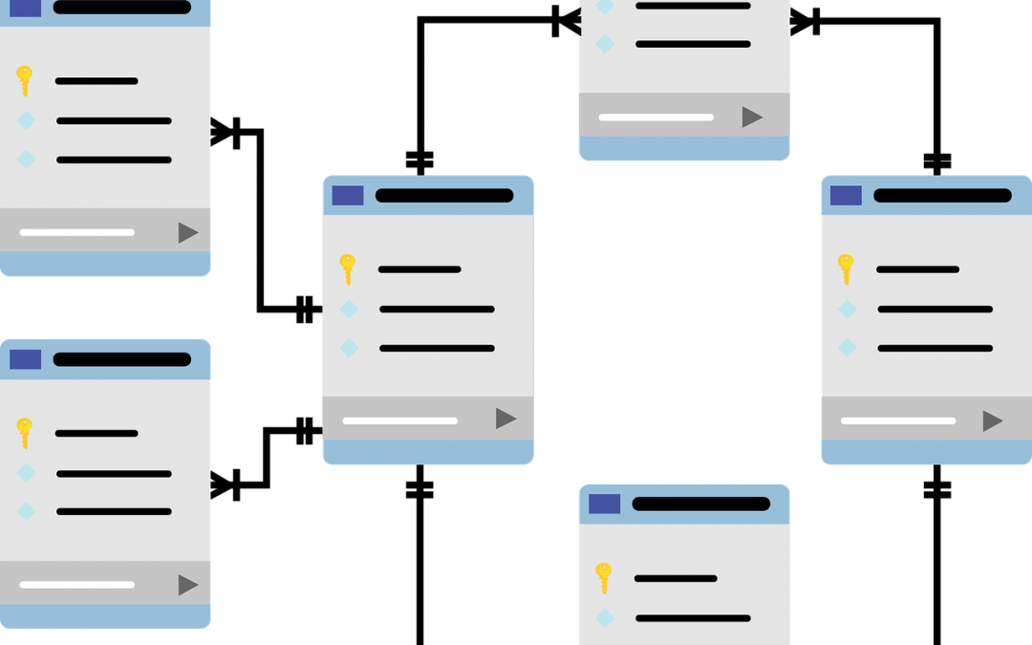
Introduction
Database
  a collection of related data and its metadata organized in a structured format for optimized information management

Slide 6
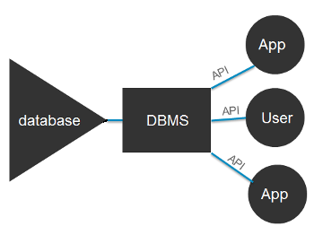
Introduction (2)
Database Management System (DBMS)
  is software that enables the easy creation, access, and modification of databases for efficient and effective database management

Slide 7
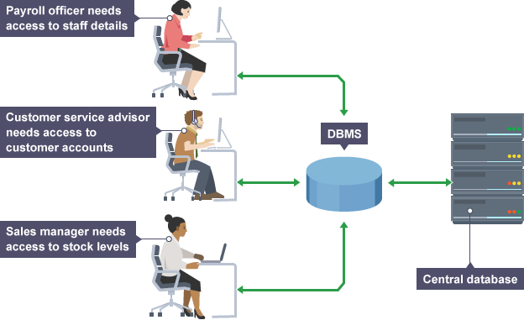
Introduction (3)
Database System
  is an integrated system of hardware, software, people, procedures, and data that define and regulate the collection, storage, management, and use of data within a database environment

Slide 8
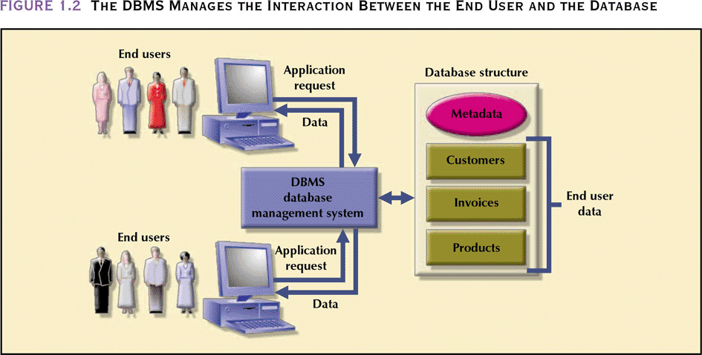
Database Management System (DBMS)
Manages interaction between end users and database

Slide 9
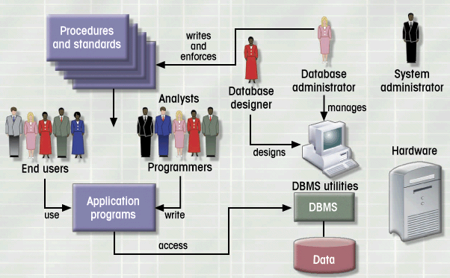
Database System Environment
Hardware
Software
  OS
  DBMS
  Applications
People
Procedures
Data

Slide 10
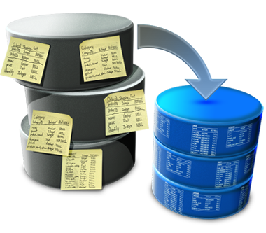
Database: Importance
Purpose of databases
  Optimizes data management
  Transforms data into information

Slide 11
Database: Importance (2)
Importance of Database Design
  Defines the database’s expected use
    different approach needed for different types of databases
  Avoid data redundancy & ensure data integrity
    data is accurate and verifiable
  Poorly designed database generates errors
    leads to bad decisions
    can lead to failure of an organization or business

Slide 12
Database: Functions
Functions of DBMS/Database System
  Stores data and related data entry forms, report definitions, etc.
  Hides the complexities of relational database model from the user
    facilitates the construction/definition of data elements and their relationships
    enables data transformation and presentation
  Enforces data integrity
  Implements data security management
    access, privacy, backup & restoration

Slide 13

Database: Planning and Analysis
1) Assess
Goal of the organization
Database environment
  existing hardware, software, raw data,
  data processing procedures

Slide 14

Database: Planning and Analysis (2)
2) Identify
Database needs
  what database can do to further
  the goal of the organization
User needs and characteristics
  who the users are, what they want to do, how they envision doing it
Database system requirements
  what the database system should do to satisfy the database and user need

Slide 15

Database: Implementation
Design
  From conceptual design to
  a detailed system specification
Implementation
  Create the database
Maintenance
  Troubleshoot, update, streamline the database

Slide 16
Database Characteristics
1) Real-world entity
  A modern DBMS is more realistic and uses real-world entities to design its architecture
2) Relation-based tables
  DBMS allows entities and relations among them to form tables
Notes:
Traditionally, data was organized in file formats. DBMS was a new concept then, and all the research was done to make it overcome the deficiencies in traditional style of data management. A modern DBMS has the following characteristics
Real-world entity − A modern DBMS is more realistic and uses real-world entities to design its architecture. It uses the behavior and attributes too. For example, a school database may use students as an entity and their age as an attribute.
Relation-based tables − DBMS allows entities and relations among them to form tables. A user can understand the architecture of a database just by looking at the table names.
Isolation of data and application − A database system is entirely different than its data. A database is an active entity, whereas data is said to be passive, on which the database works and organizes. DBMS also stores metadata, which is data about data, to ease its own process.
Less redundancy − DBMS follows the rules of normalization, which splits a relation when any of its attributes is having redundancy in values. Normalization is a mathematically rich and scientific process that reduces data redundancy.

Slide 17
Database Characteristics (2)
3) Isolation of data and application
  A database system is entirely different than its data
  A database is an active entity, whereas data is passive (allowing change without resistance)
4) Less redundancy
  DBMS follows the rules of normalization, which splits a relation when any of its attributes is having redundancy in values
Notes:
Traditionally, data was organized in file formats. DBMS was a new concept then, and all the research was done to make it overcome the deficiencies in traditional style of data management. A modern DBMS has the following characteristics
Real-world entity − A modern DBMS is more realistic and uses real-world entities to design its architecture. It uses the behavior and attributes too. For example, a school database may use students as an entity and their age as an attribute.
Relation-based tables − DBMS allows entities and relations among them to form tables. A user can understand the architecture of a database just by looking at the table names.
Isolation of data and application − A database system is entirely different than its data. A database is an active entity, whereas data is said to be passive, on which the database works and organizes. DBMS also stores metadata, which is data about data, to ease its own process.
Less redundancy − DBMS follows the rules of normalization, which splits a relation when any of its attributes is having redundancy in values. Normalization is a mathematically rich and scientific process that reduces data redundancy.

Slide 18

Database Characteristics (3)
5) Consistency
  Consistency is a state where every
  relation in a database remains
  consistent
6) Query Language
  DBMS is equipped with query language, which makes it more efficient to retrieve and manipulate data
Notes:
Consistency − Consistency is a state where every relation in a database remains consistent. There exist methods and techniques, which can detect attempt of leaving database in inconsistent state. A DBMS can provide greater consistency as compared to earlier forms of data storing applications like file-processing systems.
Query Language − DBMS is equipped with query language, which makes it more efficient to retrieve and manipulate data. A user can apply as many and as different filtering options as required to retrieve a set of data. Traditionally it was not possible where file-processing system was used.

Slide 19
Database Characteristics (4)
7) ACId Properties
  DBMS follows the concepts of Atomicity, Consistency, Isolation, and Durability (ACID)
  These concepts are applied to transactions, which manipulate data in a database
  ACId properties help the database stay healthy in multi-transactional environments and help prevent failure
Notes:
ACId Properties − DBMS follows the concepts of Atomicity, Consistency, Isolation, and Durability (normally shortened as ACID). These concepts are applied on transactions, which manipulate data in a database. ACId properties help the database stay healthy in multi-transactional environments and in case of failure.

Slide 20
Database Characteristics (5)
8) Multi User and Concurrent Access
  DBMS supports multi-user environment and allows them to access and manipulate data in parallel
9) Multiple views
  DBMS offers multiple views for different users
Notes:
Multiuser and Concurrent Access − DBMS supports multi-user environment and allows them to access and manipulate data in parallel. Though there are restrictions on transactions when users attempt to handle the same data item, but users are always unaware of them.
Multiple views − DBMS offers multiple views for different users. A user who is in the Sales department will have a different view of database than a person working in the Production department. This feature enables the users to have a concentrate view of the database according to their requirements.

Slide 21
Database Characteristics (6)
10) Security
  Features like multiple views offer security to some extent where users are unable to access data of other users and departments
  DBMS offers methods to impose constraints while entering data into the database and retrieving the same at a later stage
Notes:
Security − Features like multiple views offer security to some extent where users are unable to access data of other users and departments. DBMS offers methods to impose constraints while entering data into the database and retrieving the same at a later stage. DBMS offers many different levels of security features, which enables multiple users to have different views with different features. For example, a user in the Sales department cannot see the data that belongs to the Purchase department. Additionally, it can also be managed how much data of the Sales department should be displayed to the user. Since a DBMS is not saved on the disk as traditional file systems, it is very hard for miscreants to break the code.

Slide 22
Business Rules
Definition: Brief, precise, and unambiguous descriptions of operations in an organization
  based on policies, procedures, or principles within a specific organization
  help to create and enforce actions within that organization’s environment
  apply to any organization that stores and uses data to generate information

Slide 23
Business Rules (2)
Purposes
  Enhance understanding & facilitate communication
    Standardize company’s view of data
    Constitute a communications tool between users and designers
    Allow designer to understand business process as well as the nature, role, and scope of data
  Promote creation of an accurate data model

Slide 24

Business Rules (3)
Sources
  Interviews
    Company managers
    Policymakers
    Department managers
    End users
  Written documentation
    Procedures, Standards, Operations manuals
  Observation
    Business operations

Slide 25
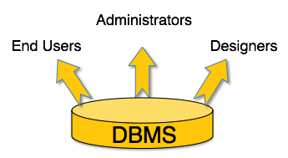
Users
Administrators
  maintain the DBMS and are responsible for administering the database
Designers
  the group of people who actually work
  on the designing part of the database
End Users
  are those who actually reap the
  benefits of having a DBMS
Notes:
A typical DBMS has users with different rights and permissions who use it for different purposes. Some users retrieve data and some back it up. The users of a DBMS can be broadly categorized as follows
Administrators − Administrators maintain the DBMS and are responsible for administrating the database. They are responsible to look after its usage and by whom it should be used. They create access profiles for users and apply limitations to maintain isolation and force security. Administrators also look after DBMS resources like system license, required tools, and other software and hardware related maintenance.
Designers − Designers are the group of people who actually work on the designing part of the database. They keep a close watch on what data should be kept and in what format. They identify and design the whole set of entities, relations, constraints, and views.
End Users − End users are those who actually reap the benefits of having a DBMS. End users can range from simple viewers who pay attention to the logs or market rates to sophisticated users such as business analysts.

Slide 26
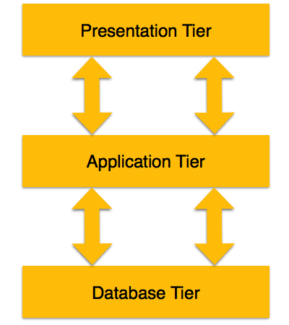
3-Tier Architecture
Notes:
A 3-tier architecture separates its tiers from each other based on the complexity of the users and how they use the data present in the database. It is the most widely used architecture to design a DBMS

Slide 27
3-Tier Architecture (2)
Database (Data) Tier
  The database resides along with its query processing languages.
  We also have the relations that define the data and their constraints at this level.
Application (Middle) Tier
  At this tier reside the application server and the programs that access the database.
  For a user, this application tier presents an abstracted view of the database.
Notes:
Database (Data) Tier − At this tier, the database resides along with its query processing languages. We also have the relations that define the data and their constraints at this level.
Application (Middle) Tier − At this tier reside the application server and the programs that access the database. For a user, this application tier presents an abstracted view of the database. End-users are unaware of any existence of the database beyond the application. At the other end, the database tier is not aware of any other user beyond the application tier. Hence, the application layer sits in the middle and acts as a mediator between the end-user and the database.
User (Presentation) Tier − End-users operate on this tier and they know nothing about any existence of the database beyond this layer. At this layer, multiple views of the database can be provided by the application. All views are generated by applications that reside in the application tier.

Slide 28
3-Tier Architecture (3)
User (Presentation) Tier
  End-users operate on this tier
  They know nothing about any existence of the database beyond this layer
  The application provides multiple views of the database at this layer
Notes:
Database (Data) Tier − At this tier, the database resides along with its query processing languages. We also have the relations that define the data and their constraints at this level.
Application (Middle) Tier − At this tier reside the application server and the programs that access the database. For a user, this application tier presents an abstracted view of the database. End-users are unaware of any existence of the database beyond the application. At the other end, the database tier is not aware of any other user beyond the application tier. Hence, the application layer sits in the middle and acts as a mediator between the end-user and the database.
User (Presentation) Tier − End-users operate on this tier and they know nothing about any existence of the database beyond this layer. At this layer, multiple views of the database can be provided by the application. All views are generated by applications that reside in the application tier.

Slide 29
Introduction to Database Systems Summary
Database System
  is an integrated system of hardware, software, people, procedures, and data
  that define and regulate the collection, storage, management, and use of data within a database environment
Purpose of a Database
  Optimizes data management
  Transforms data into information
Business rules
  Brief, precise, and unambiguous descriptions of operations in an organization
Users: administrators, end users, and designers
3-Tier Architecture: database tier, application tier, and user tier

Slide 30
5.2: Data Models
5.1: Introduction to Database Systems
5.2: Data Models
5.3: ER Diagram Representation

Slide 31
Learning Objectives
Define data models
Describe Entity-Relationship model
Describe Relational model
Understand ER model basic concepts
Notes:
Please take a moment to read the learning objectives.

Slide 32
Data Model
Data models define how the logical structure of a database is modeled
  Are fundamental entities to introduce abstraction in a DBMS
  Define how data is connected to each other and how they are processed and stored in the system.
Notes:
Data models define how the logical structure of a database is modeled. Data Models are fundamental entities to introduce abstraction in a DBMS. Data models define how data is connected to each other and how they are processed and stored inside the system.

Slide 33


Data Models: Entity-Relationship Model
Entity-Relationship (ER) Model is based on the notion of real-world entities and relationships among them
While formulating real-world scenario into the database model, the ER Model creates:
  an entity set
  a relationship set
  general attributes
  and constraints
Notes:
Entity-Relationship (ER) Model is based on the notion of real-world entities and relationships among them. While formulating real-world scenario into the database model, the ER Model creates entity set, relationship set, general attributes and constraints.

Slide 34
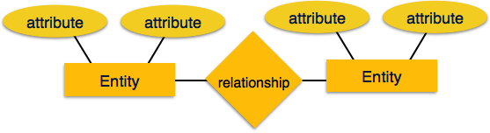
Data Models: Entity-Relationship Model (2)
ER Model is based on
  Entities and their attributes
  Relationships among entities

Slide 35
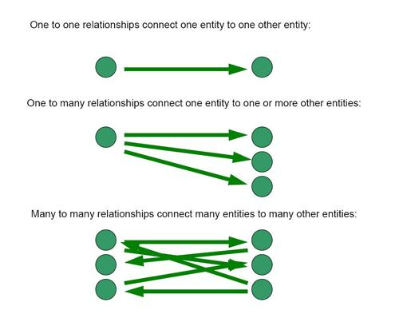
Data Models: Entity-Relationship Model (3)
Entity − An entity in an ER Model is a real-world entity having properties called attributes
  Every attribute is defined by its set of values called domains
Relationship − The logical association among entities is called relationships.
  Relationships are mapped with entities in various ways.
  Mapping cardinalities define the number of association between two entities.
Mapping cardinalities
  one-to-one
  one-to-many
  many-to-one
  many-to-many
Notes:
Data models define how the logical structure of a database is modeled. Data Models are fundamental entities to introduce abstraction in a DBMS. Data models define how data is connected to each other and how they are processed and stored inside the system.
Entity − An entity in an ER Model is a real-world entity having properties called attributes. Every attribute is defined by its set of values called domain. For example, in a school database, a student is considered as an entity. Student has various attributes like name, age, class, etc.
Relationship − The logical association among entities is called relationship. Relationships are mapped with entities in various ways. Mapping cardinalities define the number of association between two entities.
Mapping cardinalities −
one to one
one to many
many to one
many to many

Slide 36
Data Models: Entity-Relationship Model (4)
Notes:
Data models define how the logical structure of a database is modeled. Data Models are fundamental entities to introduce abstraction in a DBMS. Data models define how data is connected to each other and how they are processed and stored inside the system.
Entity − An entity in an ER Model is a real-world entity having properties called attributes. Every attribute is defined by its set of values called domain. For example, in a school database, a student is considered as an entity. Student has various attributes like name, age, class, etc.
Relationship − The logical association among entities is called relationship. Relationships are mapped with entities in various ways. Mapping cardinalities define the number of association between two entities.
Mapping cardinalities −
one to one
one to many
many to one
many to many

Slide 37
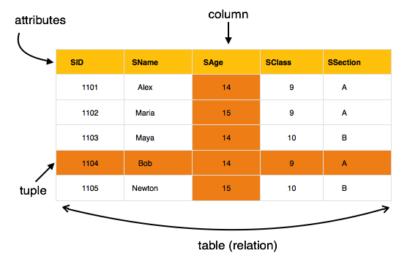
Data Models: Relational Model
The most popular data model in DBMS is the Relational Model
  It is more scientific a model than others
  Based on first-order predicate logic and defines a table as an n-ary relation

Slide 38
Data Models: Relational Model (2)
Data is stored in tables called relations
Relations can be normalized
In normalized relations, values saved are atomic values
Each row in a relation contains a unique value
Each column in a relation contains values from the same domain

Slide 39
Database Schema
Is the skeleton structure that represents the logical view of the entire database
  It defines how the data is organized and how the relations among them are associated
Defines its entities and the relationship among them
  It contains a descriptive detail of the database, which can be depicted using schema diagrams
Notes:
A database schema is the skeleton structure that represents the logical view of the entire database. It defines how the data is organized and how the relations among them are associated. It formulates all the constraints that are to be applied on the data.
A database schema defines its entities and the relationship among them. It contains a descriptive detail of the database, which can be depicted by means of schema diagrams. It’s the database designers who design the schema to help programmers understand the database and make it useful.

Slide 40
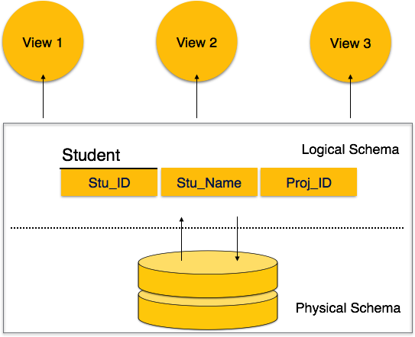
Database Schema (2)
Notes:
A database schema is the skeleton structure that represents the logical view of the entire database. It defines how the data is organized and how the relations among them are associated. It formulates all the constraints that are to be applied on the data.
A database schema defines its entities and the relationship among them. It contains a descriptive detail of the database, which can be depicted by means of schema diagrams. It’s the database designers who design the schema to help programmers understand the database and make it useful.

Slide 41
Database Schema (3)
Physical Database Schema
  Pertains to the actual storage of data and its form of storage like files, indices, etc.
  It defines how the data will be stored in secondary storage
Logical Database Schema
  Defines all the logical constraints that need to be applied to the stored data
  It defines tables, views, and integrity constraints

Slide 42
ER Model - Basic Concepts
Entity
  Can be a real-world object, either animate or inanimate, that can be easily identifiable
  For example, in a school database, students, teachers, classes, and courses offered can be considered as entities.
Attributes
  Entities are represented by their properties
    All attributes have values
  For example, a student entity may have name, class, and age as attributes
Notes:
The ER model defines the conceptual view of a database. It works around real-world entities and the associations among them. At view level, the ER model is considered a good option for designing databases.
Entity
An entity can be a real-world object, either animate or inanimate, that can be easily identifiable. For example, in a school database, students, teachers, classes, and courses offered can be considered as entities. All these entities have some attributes or properties that give them their identity.
Attributes
Entities are represented by means of their properties, called attributes. All attributes have values. For example, a student entity may have name, class, and age as attributes.

Slide 43
Types of Attributes
Simple attribute
  Atomic values, which cannot be divided further
Composite attribute
  Are made of more than one simple attribute.
  For example, a student's complete name may have first_name and last_name.
Notes:
Simple attribute − Simple attributes are atomic values, which cannot be divided further. For example, a student's phone number is an atomic value of 10 digits.
Composite attribute − Composite attributes are made of more than one simple attribute. For example, a student's complete name may have first_name and last_name.
Derived attribute − Derived attributes are the attributes that do not exist in the physical database, but their values are derived from other attributes present in the database. For example, average_salary in a department should not be saved directly in the database, instead it can be derived. For another example, age can be derived from data_of_birth.
Single-value attribute − Single-value attributes contain single value. For example − Social_Security_Number.
Multi-value attribute − Multi-value attributes may contain more than one values. For example, a person can have more than one phone number, email_address, etc.
These attribute types can come together in a way like −
simple single-valued attributes
simple multi-valued attributes
composite single-valued attributes
composite multi-valued attributes

Slide 44
Types of Attributes (2)
Derived attribute
  The attributes that do not exist in the physical database, but their values are derived from other attributes present in the database
Single-value attribute
  Contains a single value
Multi-value attribute
  May contain more than one values
Notes:
Simple attribute − Simple attributes are atomic values, which cannot be divided further. For example, a student's phone number is an atomic value of 10 digits.
Composite attribute − Composite attributes are made of more than one simple attribute. For example, a student's complete name may have first_name and last_name.
Derived attribute − Derived attributes are the attributes that do not exist in the physical database, but their values are derived from other attributes present in the database. For example, average_salary in a department should not be saved directly in the database, instead it can be derived. For another example, age can be derived from data_of_birth.
Single-value attribute − Single-value attributes contain single value. For example − Social_Security_Number.
Multi-value attribute − Multi-value attributes may contain more than one values. For example, a person can have more than one phone number, email_address, etc.
These attribute types can come together in a way like −
simple single-valued attributes
simple multi-valued attributes
composite single-valued attributes
composite multi-valued attributes

Slide 45
Entity-Set and Keys
Key is an attribute or collection of attributes that uniquely identifies an entity among entity set.
Types:
  Super Key: A set of attributes (one or more) that collectively identifies an entity in an entity set.
  Candidate Key: A minimal super key is called a candidate key. An entity set may have more than one candidate key.
  Primary Key: A primary key is one of the candidate keys chosen by the database designer to uniquely identify the entity set.

Slide 46
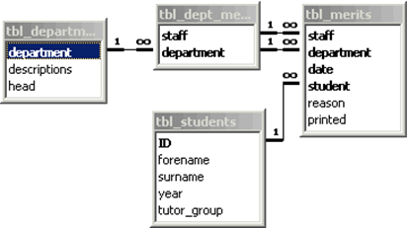
Relationship
The association among entities is called a relationship. For example, an employee works at a department, a student enrolls in a course. Works at and Enrolls are called relationships.
Degree of relationship
  Binary = degree 2
  Ternary = degree 3
  n-ary = degree

Slide 47
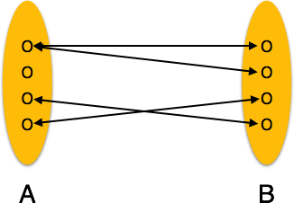
Mapping Cardinalities
Cardinality defines the number of entities in one entity set, which can be associated with the number of entities of another set via relationship set.
  One-to-one
  One-to-many
  Many-to-one
  Many-to-many

Slide 48
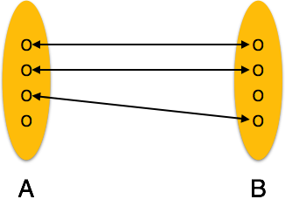
Mapping Cardinalities (2)
One-to-one − One entity from entity set A can be associated with at most one entity of entity set B and vice versa

Slide 49
Mapping Cardinalities (3)
One-to-many − One entity from entity set A can be associated with more than one entities of entity set B
However, an entity from entity set B, can be associated with at most one entity

Slide 50
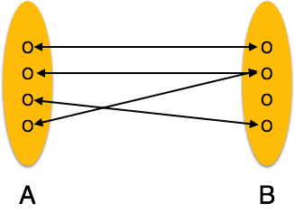
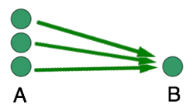
Mapping Cardinalities (4)
Many-to-one − More than one entities from entity set A can be associated with at most one entity of entity set B
However, an entity from entity set B can be associated with more than one entity from entity set A

Slide 51
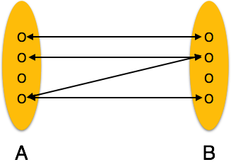
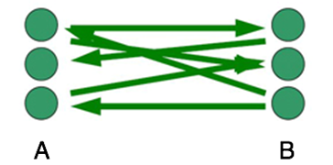
Mapping Cardinalities (5)
Many-to-many − One entity from A can be associated with more than one entity from B, and vice versa

Slide 52
Data Models Summary
Data models define how the logical structure of a database is modeled.
Entity-Relationship (ER) model is based on the notion of real-world entities and relationships among them.
The Relational model is based on first-order predicate logic and defines a table as an n-ary relation.
Database schema is the skeleton structure that represents the logical view of the entire database

Slide 53
5.3: ER Diagram Representation
5.1: Introduction to Database Systems
5.2: Data Models
5.3: ER Diagram Representation

Slide 54
Learning Objectives
Understand entity representation
Describe attribute representation
Describe relationship representation
Understand generalization
Define specialization
Describe inheritance
Notes:
Please take a moment to read the learning objectives.

Slide 55
ER Diagram Representation: Entity
Entities are represented Using rectangles
Rectangles are named with the entity set they represent
Notes:
Let us now learn how the ER Model is represented by means of an ER diagram. Any object, for example, entities, attributes of an entity, relationship sets, and attributes of relationship sets, can be represented with the help of an ER diagram.

Slide 56
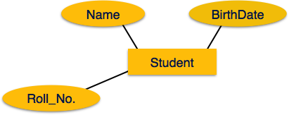
ER Diagram Representation: Attributes
Attributes are the properties of entities
Attributes are represented using ellipses
Every ellipse represents
one attribute and is
directly connected to its
entity (rectangle)

Slide 57
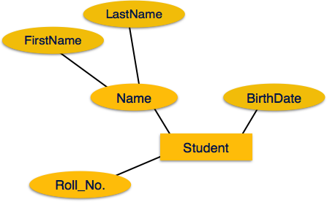
ER Diagram Representation: Attributes (2)
If the attributes are composite, they are further divided in a tree-like structure
Every node is then
connected to its attribute
Composite attributes are
represented by ellipses that are
connected with an ellipse

Slide 58
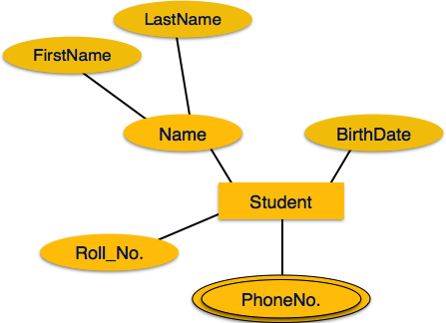
ER Diagram Representation: Attributes (3)
Multivalued attributes are depicted by a double ellipse

Slide 59
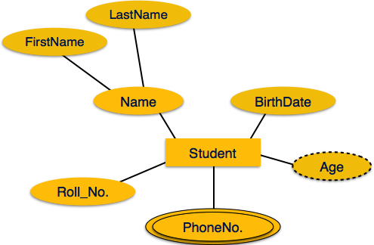
ER Diagram Representation: Attributes (4)
Derived attributes are depicted by a dashed ellipse

Slide 60
ER Diagram Representation: Relationship
Relationships are represented by a diamond-shaped box
  The name of the relationship is written inside the diamond-box
  All the entities (rectangles) participating in a relationship, are connected to it by a line
Name
(ATTRIBUTE)
Student
(ENTITY)
Enrolled
(RELATIONSHIP)
Course
(ENTITY)

Slide 61
ER Diagram Representation: Relationship
Cardinality and Binary Relationship
  Cardinality is the number of instances of an entity from a relation that can be associated with the relation
  A binary relationship is where only two entities are involved, such as artist and song

Slide 62
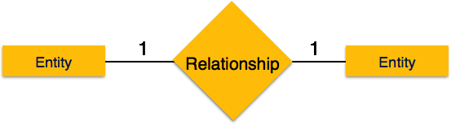
Relationship Cardinalities
One-to-one − When only one instance of an entity is associated with the relationship, it is marked as '1:1'.
The following image reflects that only one instance of each entity should be associated with the relationship.
It depicts one-to-one relationship

Slide 63
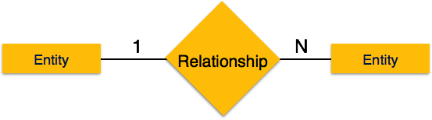
Relationship Cardinalities (2)
One-to-many − When more than one instance of an entity is associated with a relationship, it is marked as '1:N'.
The following image reflects that only one instance of an entity on the left and more than one instance of an entity on the right can be associated with the relationship.
It depicts one-to-many relationship

Slide 64
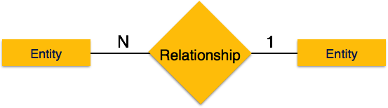
Relationship Cardinalities (3)
Many-to-one − When more than one instance of an entity is associated with the relationship, it is marked as 'N:1'.
The following image reflects that more than one instance of an entity on the left and only one instance of an entity on the right can be associated with the relationship.
It depicts many-to-one relationship

Slide 65

Relationship Cardinalities (4)
Many-to-many − The following image reflects that more than one instance of an entity on the left and more than one instance of an entity on the right can be associated with the relationship.
It depicts many-to-many relationship

Slide 66
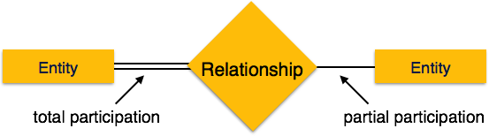
Participation Constraints
Total Participation
  When each entity is involved in the relationship set.
  Total participation is represented by double lines.
Partial participation
  Not all entities are involved in the relationship.
  Partial participation is represented by single lines.
Notes:
Total Participation is when each entity in the entity set occurs in at least one relationship in that relationship set.
For instance, consider the relationship borrower between customers and loans. A double line from loan to borrower, as shown in figure below indicates that each loan must have at least one associated customer.
In this example, every class must be taught by a faculty. However, not every class must use a textbook.

Slide 67
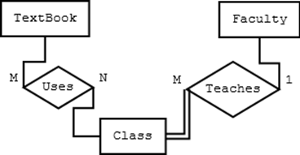
Participation Constraints (2)
For example: A Class entity cannot exist unless it is related to a Faculty member entity
Notes:
Total Participation is when each entity in the entity set occurs in at least one relationship in that relationship set.
In this example, a class cannot exist without a faculty member. However, a class does not need a textbook.

Slide 68
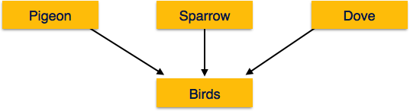
Generalization
The process of generalizing entities, where the generalized entities contain the properties of all the generalized entities, is called generalization.
In generalization, a number of entities are brought together into one generalized entity based on their similar characteristics.
Notes:
The ER Model has the power of expressing database entities in a conceptual hierarchical manner. As the hierarchy goes up, it generalizes the view of entities, and as we go deep in the hierarchy, it gives us the detail of every entity included.
Going up in this structure is called generalization, where entities are clubbed together to represent a more generalized view. For example, a particular student named Mira can be generalized along with all the students. The entity shall be a student, and further, the student is a person. The reverse is called specialization where a person is a student, and that student is Mira.

Slide 69
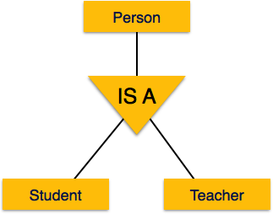
Specialization
Specialization is the opposite of generalization
In specialization, a group of entities is divided into subgroups based on their characteristics

Slide 70
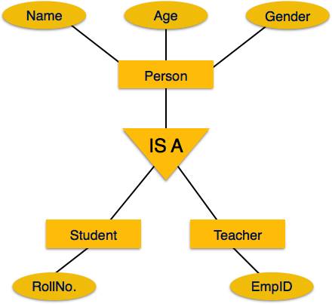
Inheritance
Inheritance is an important feature of Generalization and Specialization
It allows lower-level entities to inherit the attributes of higher-level entities

Slide 71
ER Diagram Representation Summary
Entities are represented using rectangles.
Attributes are the properties of entities. Attributes are represented using ellipses.
Relationships are represented by diamond-shaped boxes.
The process of generalizing entities, where the generalized entities contain the properties of all the generalized entities, is called generalization.
In specialization, a group of entities is divided into subgroups based on their characteristics.
Inheritance allows lower-level entities to inherit the attributes of higher-level entities.

